Slide 1









Outcomes among patients treated for tuberculosis in Limpopo Province, South Africa, 2006-2010
Mmakgotso Pilane, Lazarus Kuonza, Eric Maimela

Slide 2
Background
Globally 2 million TB deaths occur annually
South Africa is 4th among 22 highest TB burdened countries
National TB Control Programme aims to cure
  85% of patients newly diagnosed with TB
  80% of patients on retreatment
Monitoring treatment outcomes is crucial in evaluating programme performance
Notes:
The are 2 million Tuberculosis death reported world wide annually. South Africa ranked 4th among the highest TB burdened countries world wide. In mitigation, the national TB control programme aims to at least cure 85% of new smear positive cases. And 80% smear positive retreatment cases. As such monitoring treatment outcome important in monitoring programme performance.

Slide 3
Objective
To describe treatment outcomes among patients treated for TB in Limpopo Province between 2006 and 2010
Notes:
The main objective of the study was to describe the TB treatment outcomes among patients treated in Limpopo public health care facilities between 2006 to 2010.

Slide 4
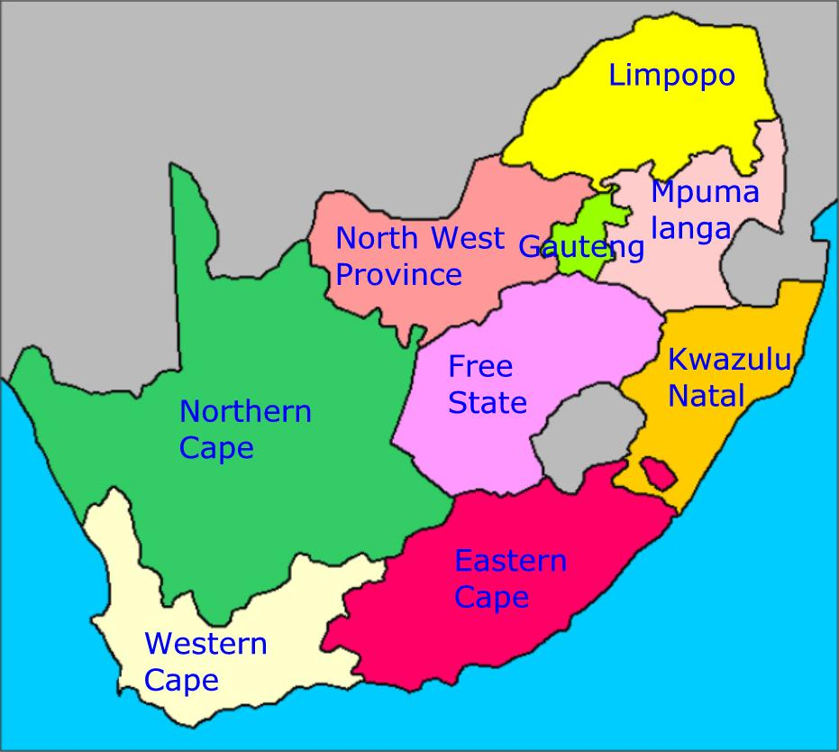
Study setting
Zimbabwe
Botswana
Mozambique
Namibia
Notes:
The province is situated in the northern part of the Republic of South Africa, and borders with Botswana, Zimbabwe and Mozambique. The province has an estimated population of about five and half million people.

Slide 5
Study design
Retrospective secondary data analysis- using ETR.NET
Patients diagnosed and treated for TB between 2006 to 2010 included in analysis
This presentation focuses on outcome among smear positive patients
Notes:
This was a cross-sectional study using historical data extracted from the Electronic Tuberculosis Register. NET. The study included patients treated for TB between 2006 to 2010.

Slide 6
Data analysis
STATATM software (Release 11) and Microsoft ExcelTM spreadsheet used for analysis
  Proportions/rates
  Graphs
Measures of association calculated included:
  odds ratio (OR)
  95% confidence interval (CI).
Notes:
We used the STATA statistical software to calculate treatment outcomes.
Microsoft Excel (2010) was used to summarize data using graphs.
Odds Ratios and their 95% confidence intervals were calculated to determine some of the factors associated with unfavourable outcomes

Slide 7
Results
Summary characteristics of the patients diagnosed in Limpopo, 2006-2010 (n=97 166)
Characteristic | n | (%)
Male | 51 475 | (53%)
Smear positive cases | 40 442 | (42%)
New cases* | 86 414 | (89%)
Mean age | 35.03 | (SD=16.5)
*Without a history of previous TB treatment
Notes:
Cumulatively 97166 cases of tuberculosis were diagnosed in Limpopo during the 5 year period. Of these cases, 53% were male, 42% were sputum smear positive.
The mean age of the cases was 35 years

Slide 8
Sputum smear positive TB cases analyzed
Sputum smear positive cases
= 40 442
New cases
=86 141
Re-treatment
=11 025
After default
=1 879
After failure
=1 148
After Relapse
=2 777
Notes:
The above flow diagram shows the break down of smear cases analysed in the study .

Slide 9
Smear conversion rates at 2nd and 3rd month of treatment , Limpopo province, 2006-10
Notes:
This graph shows the sputum smear conversion rates at the end of the second and third months of TB treatment.
The proportion of patients converting to smear negative at the end of the 2nd and 3rd months increased gradually between 2006 and 2010.
During the same period, the proportion of patients who were not evaluated at the second and third month decreased gradually.

Slide 10
Cure rates among new and retreatment TB cases in Limpopo Province, 2006-2010
Notes:
The graph shows the proportion of cases that were classified as ‘cured’ at the end of TB treatment, among the new and re-treatment cases.
Cure rates were generally lower among patients previously treated for TB compared to those that were being treated for TB for the first time.
Over the five year period the cure rates showed a gradual increase, though they remained below the national minimum target of 85%.

Slide 11
Treatment success among new and retreatment TB cases in Limpopo Province, 2006-2010
Notes:
This graph is showing the treatment success rates, which is the sum of the patients who were ‘cured’ and those who completed treatment but were not evaluated for sputum smear status at the end of treatment.
The treatment success improved over the five years, especially among the new TB cases. We also noted some decrease in the proportion of patients classified as treatment completed, without sputum evaluation – again, this trend was most notable among the new TB cases, compared to the re-treatment cases.

Slide 12
Proportion of smears remaining positive at end of treatment by year, Limpopo Province, 2006-2010
Notes:
This graph is showing the proportion of patients whose sputum remained smear positive at the end of TB treatment. Such patients are classified as treatment failure.
The treatment failure rate was below 2.5% for the whole study period. However, retreatment failure was higher among patients on TB retreatment, compared to the new cases.

Slide 13
Defaulter rates among new and retreatment TB cases by year in Limpopo Province, 2006-2010
Notes:
The graph shows the proportion of patients who defaulted TB treatment each year. According to the targets set by the National TB Control Programme, the defaulter rate should be kept below 5%.
In Limpopo province the defaulter rate was above 5% throughout the 5 year period. The rate was notably higher among patients on retreatment compared to the new cases.

Slide 14
Death rates among new and retreatment TB cases by year in Limpopo Province, 2006-2010
Notes:
This graph is showing the proportion of patients who died while on TB treatment. According to the National TB control Programme, the death rate among TB patients should be below 5%.
In Limpopo province the death rates among the TB patients were above 5% through the five year period, and the rates were also higher among patients on retreatment for TB.

Slide 15
Predictors of an unfavorable* treatment outcome among smear positive TB patients
*unfavorable outcomes = failed, died or defaulted
Notes:
We then looked at some of the variables that were associated with unfavourable treatment outcomes (defined as death, treatment default and treatment failure).
Male patients and those previously treated for TB were more likely to have had an unfavourable treatment outcome.

Slide 16
Discussion
Cure rates below national minimum targets
  Some improvements
  Were in line with average national cure rates
    51% in 2005 and 73.1% in 2010
High defaulter rates
  Cause for concern
  Contributes to high re-treatments and treatment failure
  Risk for multi-drug resistant TB
Notes:
Nationally TB cure rate was at 51% in 2005. In 2010 cure rate was 73.1% , completion rate of 78.9% Death rate of 6.5%. KZN was 45%, and WC was 71.9% in 2005. for the study period Limpopo recorded cure rate above the national average. Study conducted in Southern Ethiopia found most of defaulters stopped taking treatment at the end of intensive phase: 26% of defaulters mentioned ‘‘feeling better’’ at the end of intensive phase. In LP Death rate amongst the TB case remains unchanged and above national average, possibly due to co-morbidity. However based on the Finland study, it is difficult to explicitly determine the causal relationship between TB and death

Slide 17
Discussion
Patients not evaluated decreased
High deaths rates amongst the TB patients
  High rates of HIV and TB co-infection
  Patients on retreatment more at risk
Notes:
Nationally TB cure rate was at 51% in 2005. In 2010 cure rate was 73.1% , completion rate of 78.9% Death rate of 6.5%.For the study period Limpopo recorded cure rate above the national average. Study conducted in Southern Ethiopia found most of defaulters stopped taking treatment at the end of intensive phase: 26% of defaulters mentioned ‘‘feeling better’’ at the end of intensive phase. Patients not evaluated in Limpopo decline for the study period. In LP Death rate amongst the TB case remains unchanged and above national average, possibly due to co-morbidity. However based on the Finland study, it is difficult to explicitly determine the causal relationship between TB and death

Slide 18
Limitation
The study was reliant on secondary data.
Data lacked some elements that could assist in understanding cause for poor outcome were lacking
Notes:
The study was reliant on secondary data, which was never meant for research.
Data lacked some elements that could assist in understanding course for poor outcome were lacking, e,g socioeconomic factors and smoking behavior.

Slide 19
Conclusion
Treatment success among TB patients showed some improvement through the five year period, but remain below national minimum targets.
Notes:
The treatment success among TB patients in Limpopo Province showed improvement through the five year period, but remain below national minimum targets.

Slide 20
Recommendations
TB control programme must be encouraged to intensify their efforts.
Strengthen patient tracing effort, counselling and home visits to reduce defaulter rates
Other factors contributing to unfavourable treatment outcomes in the province should be further explored
Notes:
The Provincial TB Directorate should Strengthen patient tracing effort from the district up to facility level, counselling and home visits to reduce defaulter rates
Factors contributing to unfavourable treatment outcomes in the province should be explored further, e.g socio-economic circumstances of the defaulters and behavioural factor, such as alcohol and smoking.

Slide 21
Acknowledgements
University of Pretoria, School of Health systems and Public Health
Department of health, Limpopo Province
South Africa Field Epidemiology and Laboratory Training Programme(SA FELTP)
Notes:
I would like to acknowledge the following who made the study possible.

Slide 22
THANK YOU

