Slide 1
The association between blood pressure, body composition and birth weight of rural South African children: Ellisras longitudinal study
Makinta MJ¹, Monyeki KD¹, Kemper HCG², Twisk JWR³
¹ Department of Human Physiology, University of Limpopo (Medunsa Campus), P.O Box 130, MEDUNSA, South Africa
² VU University Medical Center, Institute for Research in Extramural Medicine (EMGO), Amsterdam, Netherlands
³ Department of Clinical Epidemiology and Biostatistics, VU University Medical Centre, the Netherland

Slide 2
Introduction
High blood pressure in children.
Prevalence of hypertension is increasing according to recent studies .
Risk of developing high blood pressure and CVD later in life is associated with birth weight.
Any 1 kg increase in birth weight = approximately 3 mm Hg lowering in systolic blood pressure
Body composition  associated with development of hypertension later in life.
Body fat distribution  CVD and hypertension in adults.

Slide 3
Situation in the ELS sample
Prevalence of hypertension ranges between 1% to 11.4% and for overweight ranges between 0 and 4.6 % for Ellisras rural children aged 7 to 13 years (Monyeki et al 2008).
Prevalence of under nutrition
sever ranges between 7.1% to 53.7%,
moderate ranges between 12.2% to 23.8%,
and mild ranges between 12.6 and 47.6 % in children aged 7 to 13 yrs. (Monyeki et al 2008).
In this population BP was significantly associated with waist girth, triceps and subscapular skin folds (Monyeki et al 2008)

Slide 4
Aim
To investigate
relationship between BP, body composition and birth weight of children aged 4 - 15 years participating in Ellisras Longitudinal Studies (ELS)
Prevalence of low birth weight, hypertension and under nutrition
Risk of hypertension in under nourished children.

Slide 5
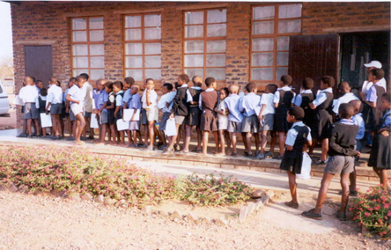
Sampling
Birth weight was recorded from immunization card out of 2238 ELS subjects
Only 528 have birth weight recorded.
Exclusion criteria
No immunization card.
No extrapolation possible  no records on the immunization card after several visit to the health care centre.

Slide 6
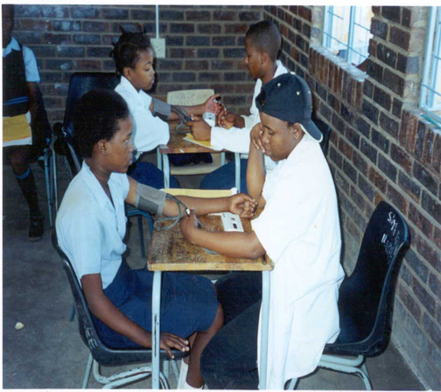
Blood pressure (BP)
Omron electronic Micronta monitoring kit following by National High Blood Pressure Education Program guidelines (1996).
Both automated device and sphygmomanometer used
High correlation (r = 0.93) was found in a pilot study
Hypertension  BP levels ≥ to the 95th percentile adjusted for height and sex.

Slide 7
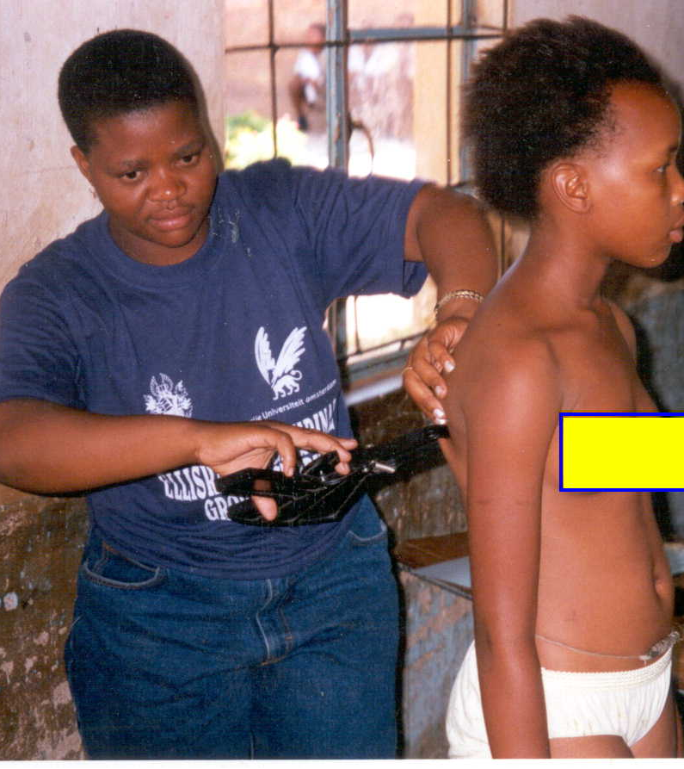
Anthropometry
Anthropometric measurements according International Society for the Advancement of Kinanthropometry.
Obesity and underweight  internationally recommended cut-off points for BMI in children.

Slide 8
Statistical analysis
Student t-test  test significance between sexes.
Partial correlations coefficient & linear regression model calculated
Subjects classification according to Cole et al. cut-off point.
normal,
overweight
obese
Logistic regression model  direction of association
All statistical analyses performed using Statistical Package for the Social Sciences (SPSS).
The statistical significance was set at p < 0.05

Slide 9
Results

Slide 10
Table 1: Descriptive statistics of body size, birth weight, body composition and BP of children participating in ELS
Variable | Boys (n =299) |  | Girls (n =229)
 | mean | sd | mean | sd | P
SBP | 95.7 | 10.60 | 99.3 | 11.33 | 0.000
DBP | 59.7 | 6.86 | 62.7 | 7.82 | 0.000
WHR | 0.9 | 0.06 | 0.8 | 0.07 | 0.000
Triceps | 5.9 | 1.48 | 7.4 | 2.38 | 0.000
Biceps | 4.6 | 1.06 | 5.5 | 1.85 | 0.000
Suprailiac | 4.4 | 1.37 | 5.1 | 1.83 | 0.000
Subscapular | 5.2 | 1.00 | 6.2 | 1.75 | 0.000
Sum4sk | 20.1 | 4.27 | 24.2 | 7.14 | 0.000
FM | 3.6 | 1.21 | 3.4 | 1.78 | 0.004
% BF | 14.2 | 2.28 | 13.0 | 3.39 | 0.000
SBP = systolic BP; DBP = diastolic BP; WHR = waist-to-hip ratio;

Slide 11
Table 4: Summary of regression model for crude & adjustable regression coefficient (β), 95% CI & p-value for the association between SBP, body composition and birth weight.
Variable |  | Crude |  |  |  | Adjusted for age and gender
Systole
 | β |  | p<0.05 | 95% CI | 95%CI | β | p<0.05 | 95% CI | 95%CI
∑₄SF | 0.35 |  | 0.000 | 0.19 | 0.51 | 0.18 | 0.026 | 0.22 | 0.338
FM | 2.14 |  | 0.000 | 1.52 | 2.75 | 1.38 | 0.000 | 0.69 | 2.06
FFM | 1.07 |  | 0.000 | 0.87 | 1.26 | 1.07 | 0.000 | 0.76 | 1.39
% BF | 0.40 |  | 0.018 | 0.07 | 0.73 | 0.32 | 0.050 | -0.001 | 0.64
BMI | 2.27 |  | 0.000 | 1.60 | 2.94 | 1.58 | 0.000 | 0.91 | 2.26
WHR | -22.68 |  | 0.002 | -37.14 | -8.22 | 1.68 | 0.823 | -13.43 | 16.81
∑₄SF = sum of 4 skinfolds; FM = fat mass; FFM =fat free mass; BMI = body mass index;

Slide 12
Table 4: Summary of regression model for crude & adjustable regression coefficient (β), 95% CI & p-value for the association between DBP, body composition and birth weight.
Variable | Crude |  |  |  | Adjusted for age and gender
Diastole
 | β | p-value | 95% CI | 95%CI | β | p-value | 95% CI | 95%CI
∑₄SF | 0.21 | 0.000 | 0.10 | 0.31 | 0.09 | 0.123 | -0.02 | 0.19
FM | 1.04 | 0.000 | 0.62 | 1.46 | 0.65 | 0.006 | 0.18 | 1.12
FFmass | 0.53 | 0.000 | 0.39 | 0.67 | 0.48 | 0.000 | 0.26 | 0.70
BMI | 1.25 | 0.000 | 0.79 | 1.70 | 0.88 | 0.000 | 0.42 | 1.46
WHR | -19.37 | 0.000 | -29.05 | -9.70 | -5.08 | 0.33 | -15.40 | 5.28

Slide 13
Figure 2: Prevalence of hypertension , overweight, obesity , over fatness & low birth weight of children participating in ELS

Slide 14
Figure 2: Prevalence of under weight (characterized as severe, moderate and mild) of children participating in ELS

Slide 15
Table 6: Odds ratio, 95% Cl and p-value of high BP and underweight children participating in ELS
Variable | Unadjusted |  |  |  | Adjusted for age and gender
High Systole
 | OR | p<0.05 | 95% CI | 95%CI | OR | p<0.05 | 95% CI | 95%CI
Under nutrition | 0.53 | 0.109 | 0.24 | 1.16 | 0.53 | 0.322 | 0.24 | 1.18
High Diastole
Under nutrition | 0.57 | 0.192 | 0.25 | 1.33 | 0.55 | 0.16 | 0.23 | 1.28
Hypertension
Under nutrition | 0.56 | 0.008 | 0.01 | 0.47 | 0.05 | 0.007 | 0.06 | 0.45

Slide 16
Discussion
Birth weight –ve associated with most body compositions although insignificant.
No relationship between birth weight, WHR and BMI  ? correct measure for assessing body fatness. Kemper et al (1999).
Both SBP and DBP associated with BMI as observed by Chiolero et al (2007)
WHR predictor of SBP as observed Lurbe et al 1998
+v relationship between under nutrition and hypertension
Prevalence of under nutrition was higher than expect.

Slide 17
Discussion (Cont…)
No relationship between birth weight and BP
significant association in small studies could be due to bias
routine medical examination
might be as a result of aged of the subject
Insignificant association between birth weight and BP, and high prevalence of malnutrition can be associated with mild growth retardation  poor food intake in rural children

Slide 18
Conclusion & Recommendations
This study suggests that impaired childhood growth, reflected by low body weight and fat free mass, is negatively associated with development of hypertension.
Further studies  look at the levels of serum biochemical and hematological parameters occurs overtime.

