Slide 1
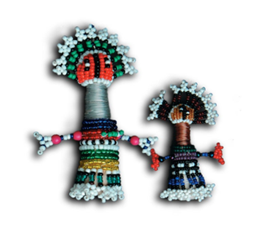
Trends in malaria incidence and indoor residual spraying coverage in Mutale Municipality, Vhembe District, Limpopo Province, 2005 to 2010
Ester Khosa^{1,2}, L. Kuonza^{1,2}, E. Maimela ³, P. Kruger ³
¹South African Field Epidemiology and Laboratory Training Programme; ²School of Health System and Public Health, University of Pretoria; ³Limpopo Department of Health and Social Development
Notes:
Good day to you all,
My name is Ester Khosa
I will be presenting to you the research study titled “Trends in malaria incidence and indoor residual spraying coverage in Mutale Municipality, Vhembe District, Limpopo Province, 2005 to 2010

Slide 2
Layout
Introduction
Aim of the study
Objectives
Methodology
Results
Discussion & conclusion
Limitations
Recommendations
Acknowledgements
Notes:
This the layout of my presentation

Slide 3
Introduction
Malaria is a major public health concern in many parts of the world
Sub-Saharan Africa where at least 60% of the global malaria cases and 90% of the deaths occur
Malaria is a leading cause of morbidity and mortality, affecting young children & and pregnant women
Malaria is endemic in parts of South Africa
The country has a well established malaria control programme since the 1930s
Notes:
Malaria is a major public health concern in many parts of the world,
especially in Sub-Saharan Africa where at least 60% of the global malaria cases and 90% of the deaths occur.
The disease is a leading cause of morbidity and mortality, mostly affecting young children (below five years of age) and pregnant women (1,2).
Malaria is endemic in some parts of South Africa.
And The country has a well established malaria control programme,
and has implemented malaria control interventions since the 1930s (3).
And the disease is now limited to the low lying north-eastern parts of Limpopo, Mpumalanga and KwaZulu Natal Provinces,
along the borders with Zimbabwe and Mozambique

Slide 4
Cont…
Each year Limpopo province reported the largest number of the malaria cases diagnosed in South Africa
The majority of the cases have been diagnosed in Mutale Local Municipality
Notes:
Over the past decade,
Limpopo province has reported the largest proportion of the malaria cases diagnosed in South Africa each year (5).
The majority of the cases have been diagnosed in Mutale Local Municipality, which is located at the north-eastern border of Vhembe District, along the border with Zimbabwe and Mozambique (4,5).

Slide 5
Figure 1: Map showing the geographical location of Mutale Local Municipality in Limpopo Province and in South Africa
Notes:
This is the geographical location of Mutale Municipality

Slide 6
Cont…
South Africa has set a target to eliminate local mosquito-borne transmission of malaria by the year 2018
It is crucial to monitor trends in morbidity and mortality due to malaria in the affected populations, in order to guide and refine control interventions.
Notes:
South Africa has set a target to eliminate local mosquito-borne transmission of malaria by the year 2018.
According to the World Health Organization (WHO), malaria elimination can be envisaged when the malaria control programme is succeeding in reducing the burden of morbidity and mortality to marginal levels
Accordingly, as the country moves forward with the malaria elimination efforts, it is crucial to monitor trends in morbidity and mortality due to malaria in the affected populations, in order to guide and refine control interventions

Slide 7
Aim of the study
To describe the trends in malaria incidence
Indoor Residual Spraying (IRS) patterns in Mutale Municipality between 2005 and 2010 in order to evaluate the malaria elimination strategy in the province
Notes:
The aim of the study is To describe the trends in malaria incidence and Indoor Residual Spraying (IRS) patterns in Mutale Municipality between 2005 and 2010 in order to evaluate the malaria elimination strategy in the province

Slide 8
Objectives
To evaluate the impact of malaria indoor residual household spraying program (IRS) that is implemented in the Mutale Local Municipality using the secondary data
Notes:
The purpose of the study is to evaluate the impact of malaria indoor residual household spraying program (IRS) that is implemented in the Mutale Local Municipality using the secondary data on IRS
during the period of July 2005 to June 2010.

Slide 9
Methods
Study Design:
Retrospective descriptive analysis of malaria data
Study sample:
Malaria cases reported in Mutale from July 2005 to June 2010
IRS data for 2005-2010 malaria seasons
Data analysis: Epi Info (version 3.3.2)
Notes:
We conducted Retrospective Descriptive epidemiological analysis of malaria data routinely collected through the provincial malaria information system between July 2005 and June 2010.
Study sample: Malaria cases reported in Mutale
IRS data for 2005-2010 malaria seasons
Epi Info (version 3.3.2) was used to analyze data

Slide 10
Results
4663 malaria cases were diagnosed
3161(68.2%) captured as locally transmitted cases
55% male
2 pregnant women
16 deaths – no death in < 15 years
25-34yrs mostly affected age group
Notes:
In total the data set had 4663 malaria cases records which were diagnosed between July 2005 and June 2010.
Out of these, 3161 (68.2%) malaria cases were recorded as locally transmitted malaria in Mutale
55% of the cases were male
Two of cases were pregnant women
16 deaths records of malaria related
and no death in < 15 yrs
The Most affected age group was btwn 25-34yrs

Slide 11
Figure 2: Distribution of diagnosed malaria cases and their origin by malaria season, Mutale Municipality, Limpopo province, July 2005 to June 2010
Notes:
This Figure shows the distribution of the malaria cases by malaria season and by the origin of the malaria.
Malaria cases in Mutale peaked during the 2007-2008 malaria season, before decreasing gradually in the subsequent two seasons.
In total, 4663 malaria cases were diagnosed in Mutale between July 2005 and June 2010.
Out of these, 3181 (68.2%) were captured as locally transmitted malaria,
231 (5%) were imported malaria,
105 (2.3%) untraceable,
and the rest, 1146 (24.6%), had no classification on the source of the malaria.
the majority (96.1%) were imported from Zimbabwe,
and the rest were imported from Mozambique (7 cases), Malawi (1 case) and Zambia (1 case).

Slide 12
Figure 3: Distribution of malaria incidence rates and case fatality rates per malaria season, Mutale Municipality, Limpopo province, July 2005 to June 2010
Notes:
Apart from the 2007-2008 malaria season,
the annual malaria incidence rates in Mutale decrease from 13.6 cases per 1,000 population in the 2005-2006 season to 2.7 cases per 1,000 population in the 2009-2010 season (p<0.001).
During the 2007-2008 malaria season the malaria incidence rate surged to 17.0 cases/1,000 population.
This figure also shows the distribution of malaria incidence rates and case fatality rates per malaria season
A total 21 malaria deaths were recorded in Mutale for the study period,
indicating a mean case fatality rate of 0.45% per malaria season
The case fatality rates were fairly stable (below 0.6%) during the first four seasons,
and increased sharply to 2.1% during the 2009-2010 season

Slide 13
Table 1: Malaria incidence rates & case fatality rates by age category, Mutale Municipality, July 2005 to June 2010
Age group category | Number of cases§ | Number of deaths | Incidence rate/1,000 population per year§ |  | Case Fatality Rate/100 malaria cases*
 |  |  | Rate | (95% CI) | Rate | (95% CI)
0-4 | 336 | 0 | 5.82 | (5.22-6.47) | 0 | -
5-14 | 940 | 0 | 7.74 | (7.26-8.24) | 0 | -
15-24 | 1072 | 1 | 10.95 | (10.31-11.62) | 0.08 | (0.004-0.41)
25-34 | 796 | 10 | 13.34 | (12.46-14.30) | 1.11 | (0.57-1.94)
35-44 | 470 | 3 | 13.46 | (12.29-14.70) | 0.60 | (0.15-1.60)
> 44 | 656 | 7 | 10.50 | (9.73-11.32) | 1.03 | (0.32-1.43)
Total | 4270 | 21 | 9.84 | (9.55-10.14) | 0.50 | (0.29-0.68)
Notes:
This Table shows the distribution of the mean malaria incidence rates and case fatality rates in Mutale for the five malaria seasons by age categories
Mean malaria incidence rates increased from 6 cases per 1,000 population per year in children below 5years
to 10 cases per 1,000 population per year in patients above 44 years (p<0.0001).
The mean malaria incidence rates peaked among people aged between 25 and 44 years.
Throughout the five malaria seasons they did not report any malaria deaths in children below 15 years of age.
The case fatality rate rose with increasing age,
from 0% in children below five years to above 1% in people above 44 years of age (p=0.0001) as shown on the Table

Slide 14
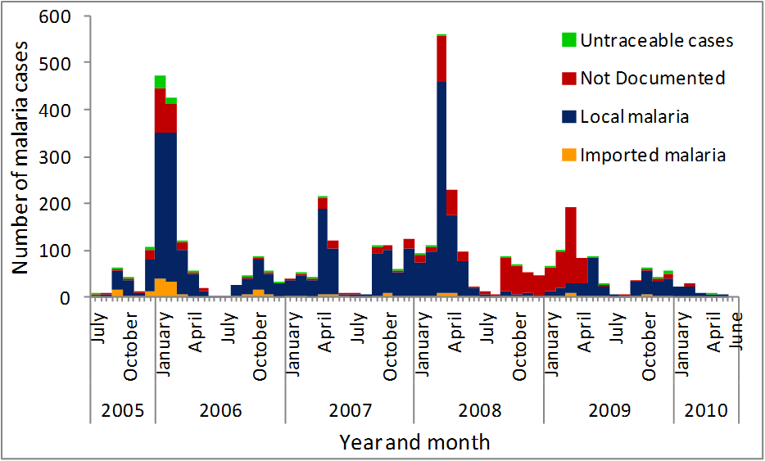
Figure 4: Number of malaria cases by month and year of diagnosis, Mutale Municipality, July 2005 to June 2010
Notes:
This Figure shows the seasonal variation in the transmission of malaria in Mutale during the five year study period.
Malaria transmission in Mutale occurred mostly from September to May,
and the cases became very low during the winter months of June and July.
The peak incidences decreased gradually over the five years,
with the exception of the 2007-2008 season when there was a surge in malaria cases during March 2008.
The number of imported malaria cases also decreased steadily from 110 cases during the 2005-2006 season,
to 11 cases during the 2009-2010 season.
Of the 831( %) malaria cases reported during the 2008-2009 season,
590 (71%) had no documentation of the source of the malaria infection

Slide 15
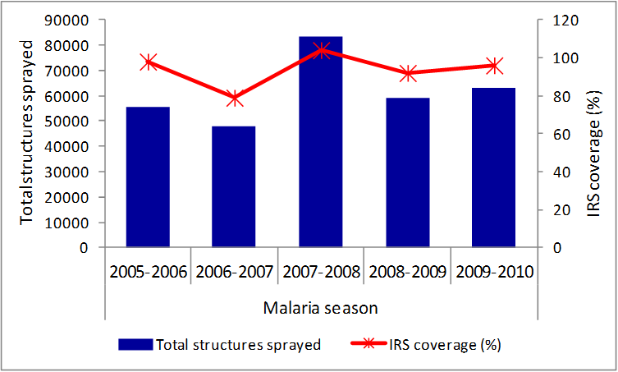
Figure 5: Number of household structures sprayed and the IRS coverage per spraying season, Mutale Municipality, July 2005 to June 2010
Notes:
This Figure shows the total number of household structures sprayed during each IRS season and the IRS coverage for each season.
The total structures sprayed decreased by 14% from 55,448 in the 2005-2006 season to 47,806 in the next season,
before increasing sharply (by 74%) to 83,291 household structures during the 2007-2008 malaria season.
A similar trend was observed in the IRS coverage.

Slide 16
Discussion & Conclusion
South Africa targets to maintain malaria case fatality rates (CFR) below 0.5%
CFR was highest among >25 years of age
These findings are in contrast to figures reported in most developing countries , where the majority of malaria deaths occur in children < five years
The study revealed that malaria CFR increased with age in Mutale
Notes:
One of the targets of the malaria control program in South Africa is to maintain malaria case fatality rates (CFR) below 0.5%
and CFR was highest among the population above 25 years of age. Exceding the 0.5% national target
The present study revealed that malaria case fatality rates in Mutale increased with age btwn 1.03-1.11/100 000
A previous study conducted in Limpopo in 2008 also reported higher malaria CFRs in the older population,
and they attributed this to the possibility of more severe malaria in the elderly
and also the possibly of poor health seeking behavior in this age group

Slide 17
Cont.....
Mutale municipality :
Experienced a surge in the incidence of malaria during the 2007-2008 season - Despite IRS coverage exceeding 100%
A malaria outbreak in March to April 2008
Notes:
Mutale municipality experienced a surge in the incidence of malaria during the 2007-2008 season.(17/1000 population)
Despite the high IRS coverage achieved during this season exceeding 100%
This was attributed to an outbreak which occured from March through to April in 2008.
The outbreak was related to excessive rainfall recorded in the province from January to March 2008.

Slide 18
Cont…
Excessive rainfall has shown to increase malaria transmission in various ways:
Firstly - it provides breeding pools for mosquitoes leading to an increased population of the malaria vector
Secondly - the high temperatures and humidity compel people to spend the nights in cooler open areas outside the houses
Thirdly - heavy rainfall interrupts the IRS programme, as some communities become inaccessible due to bad roads, flooding, etc.
Notes:
Studies have shown that Excessive rainfall can lead to an increase of malaria transmission in various ways:
Firstly - it provides breeding pools for mosquitoes leading to an increased population of the malaria vector
Secondly, the high temperatures and humidity often associated with high rainfalls, compel people to spend the nights in cooler open areas outside the houses (or with open windows) thus further exposing them to the malaria vectors.
Thirdly, prolonged heavy rainfall interrupts the IRS programme by disrupting the movement of the teams that will be conducting IRS, as some communities become inaccessible due to bad roads, flooding, etc.

Slide 19
Cont...
Findings demonstrated a decreasing trend in malaria morbidity in Mutale
Attributed : to the scaling up of IRS in the country
Introduction & Implementation of widespread use of Artemisinin-based Combination Therapy (ACTs)
Implementation of the tri-national Lubombo Malaria Protocol contributed to the decline in malaria in Mutale
The protocol was signed in 1999 by South Africa, Swaziland and Mozambique as part of the Lubombo Spatial Development Initiative (LSDI
The protocol strengthened the vector control & case management components
Notes:
Our findings demonstrated an overall decreasing trend in malaria morbidity in Mutale during the five year period under study.
This is in line with patterns that have been reported elsewhere in Limpopo province and in other malaria endemic provinces
The decrease has been attributed to the synergistic effect of the scaling up of IRS in the country
Introduction & Implementation of widespread use of Artemisinin-based Combination Therapy in the treatment of malaria in 2004) improved the malaria cure rates
The implementation of the tri-national Lubombo Malaria Protocol possibly contributed to the decline in malaria in Mutale
The protocol which was signed in 1999 by the governments of South Africa, Swaziland and Mozambique as part of the Lubombo Spatial Development Initiative (LSDI) which was aimed at enhancing economic development in the Lubombo region
(a mountainous region shared by the three countries).
The signed protocol has strengthened the vector control (using IRS)
and the case management components of the malaria control programme in the region.
Although Mutale does not directly fall within the Lubombo region,
But the municipality significantly benefited from the reduction in malaria in this neighboring region, through reduction in malaria importation.

Slide 20
Cont…
Mutale municipality has managed to maintain high IRS coverage's
Hence the decreasing trend in malaria incidences which suggest that the malaria control efforts implemented have been effective
Notes:
Indoor residual spraying is the primary vector control intervention that is used to reduce malaria transmission in South Africa.
Accordingly, IRS is the cornerstone of malaria control efforts in Limpopo province
Throughout the period under study the municipality has managed to maintain high IRS coverage's (above 80%)
And sum Studies have shown that when at least 85% of households in a community are treated or sprayed,
IRS can effectively prevent the transmission of malaria in that population
Hence The decreasing trend in malaria incidences in Mutale
Which suggest that the malaria control efforts implemented during this have been fairly effective.

Slide 21
Limitations
24% of the cases had no documentation of the location where malaria was contracted
the population of Mutale is divided into villages
village-specific population figures were not obtained
the number of household structures per village could not be obtained
the data used is routinely collected through the provincial malaria surveillance system
Further enquiry on how the province derives IRS targets revealed that the actual population of household structures in Mutale municipality is not documented
Notes:
Our study has several limitations that should be taken into account when interpreting the findings.
Firstly, twenty four percent of the malaria cases had no documentation of the location where malaria was presumably contracted.
Some of these could have been people who came for the treatment of the malaria from outside Mutale, and thus could have resulted in an overestimation of the true incidence of malaria in Mutale since we included them in the incidence calculations.
Secondly, though the population of Mutale is administratively divided into villages,
we could not obtain village-specific population figures, and thus we could not calculate the malaria incidences at the sub-municipality level to determine the problematic areas in terms of the high risk of malaria transmission.
Similarly the number of household structures per village could not be obtained, thus we could not determine the IRS coverage down to the village level.
The findings would have been more useful if we had managed to map the malaria incidence rates and IRS coverage in Mutale at sub-municipality level.
Thirdly, the data used in this study is routinely collected through the provincial malaria surveillance system, which relies mostly on passive reporting.
It is therefore possible that some malaria cases (or deaths) could have been missed by the system (because of non-reporting, mis-diagnoses, etc), thereby underestimating the true incidence of malaria (or the malaria CFRs).
Further enquiry on how the province derives IRS targets revealed that the actual population of household structures in Mutale municipality is not documented.
During IRS season planning the programme managers’ estimate the targeted structures
based on the number of household structures that were sprayed in the previous season.

Slide 22
Recommendations
MCP in Limpopo should
strengthen the surveillance, reporting and
the capturing of the data in the provincial malaria information system
work closely with the local community leaders in order to obtain accurate figures for the population & house structures
regularly updating of number of household structures targeted for IRS
Notes:
Our recommendations to the MCP in Limpopo are:
to strengthen the surveillance, reporting and the capturing of the data in the provincial malaria information system
This is especially important for areas like Mutale Municipality where there is high potential for malaria importation through the porous borders with Zimbabwe and Mozambique, countries which remain highly endemic.
working closely with the local community leaders in order to obtain accurate figures for the population & house structure at community level.
And to also Regularly update of the number of household structures targeted for IRS

Slide 23
Cont…
Patients diagnosed should be investigated
- i.e. whether locally transmitted or imported
As the country moves forward with the malaria elimination efforts, it is crucial to monitor trends in morbidity and mortality due to malaria in the affected populations, in order to guide and refine control interventions
Notes:
Patients diagnosed should be thoruoghly investigated
- i.e. to detrmine whether they were locally transmitted or imported
As the country moves forward with the malaria elimination efforts, it is crucial to monitor trends in morbidity and mortality due to malaria in the affected populations, in order to guide and refine control interventions.
THANK YOU

Slide 24
References
1. Roll Back Malaria. Malaria Key Facts [Internet]. The Global Partnership for a Malaria-free World. [cited 2012 Jan 30]. Available from: http://www.rbm.who.int/keyfacts.html
2. Heyman DL. Control of communicable diseases manual. 19th ed. United States of America: American Public Health Association; 2008.
3. Malaria control in South Africa – challenges and successes [Internet]. [cited 2012 Jan 26]. Available from: http://www.samj.org.za/index.php/samj/article/download/304/354
4. Malaria in Southern Africa [Internet]. [cited 2012 Jan 26]. Available from: http://www.malaria.org.za/Malaria_Risk/Update/update.html
5. Malaria cases in South Africa 1988-2008 [Internet]. [cited 2012 Jan 26]. Available from: http://www.malaria.org.za/Malaria_Risk/Cases/cases.html
6. Malaria Elimination Strategy 2011-2018 in South Africa. National Department of Health; 2011.
7. Malaria elimination: A field manual for low and moderate endemic countries [Internet]. [cited 2012 Jan 26]. Available from: http://whqlibdoc.who.int/publications/2007/9789241596084_eng.pdf
8. Gerritsen AA, Kruger P, van der Loeff MF, Grobusch MP. Malaria incidence in Limpopo Province, South Africa, 1998–2007. Malaria Journal. 2008 Aug 25;7(1):162.
9. Department of Health. Guideline for prevention of malaria in South Africa. Department of Health; 2009.
10.Okell LC, Drakeley CJ, Ghani AC, Bousema T, Sutherland CJ. Reduction of transmission from malaria patients by artemisinin combination therapies: a pooled analysis of six randomized trials. Malaria Journal. 2008 Jul 9;7(1):125.
11.John CC. Possible Interruption of Malaria Transmission, Highland Kenya, 2007–2008. Emerging Infectious Diseases [Internet]. 2009 Dec [cited 2012 Jan 30];15(12). Available from: http://wwwnc.cdc.gov/eid/article/15/12/09-0627_article.htm

Slide 25
Cont....
12.Okell LC, Drakeley CJ, Bousema T, Whitty CJM, Ghani AC. Modelling the Impact of Artemisinin Combination Therapy and Long-Acting Treatments on Malaria Transmission Intensity. Riley S, editor. PLoS Medicine. 2008;5(11):e226.
13.Sharp BL, Kleinschmidt I, Streat E, Maharaj R, Barnes KI, Durrheim DN, et al. Seven Years of Regional Malaria Control Collaboration—mozambique, South Africa, and Swaziland. The American Journal of Tropical Medicine and Hygiene. 2007 Jan 1;76(1):42 –47.
14.Lubombo Spatial Development Initiative [Internet]. LSDI Malaria Contorl Programme. [cited 2012 Jan 30]. Available from: http://www.malaria.org.za/lsdi/Overview/Publications.html
15.Loevinsohn ME. Climatic warming and increased malaria incidence in Rwanda. Lancet. 1994 Mar 19;343(8899):714–8.
16.Teklehaimanot HD, Lipsitch M, Teklehaimanot A, Schwartz J. Weather-based prediction of Plasmodium falciparum malaria in epidemic-prone regions of Ethiopia I. Patterns of lagged weather effects reflect biological mechanisms. Malar. J. 2004 Nov 12;3:41.
17.Indoor residual spraying: Use of indoor residual spraying for scaling up global malaria control and elimination. WHO publications [Internet]. [cited 2012 Jan 26]. Available from: http://whqlibdoc.who.int/hq/2006/WHO_HTM_MAL_2006.1112_eng.pdf
18.Implementation of Indoor Residual Spraying of Insecticides for Malaria Control in the WHO African Region Report [Internet]. [cited 2012 Jan 26]. Available from: http://www.afro.who.int/index.php?option=com_docman&task=doc_download&gid=137
19.Mabaso MLH, Sharp B, Lengeler C. Historical review of malarial control in southern African with emphasis on the use of indoor residual house‐spraying. Tropical Medicine & International Health. 2004 Aug 1;9(8):846–56.
20.Breman JG, Holloway CN. Malaria surveillance counts. Am. J. Trop. Med. Hyg. 2007 Dec;77(6 Suppl):36–47.

Slide 26
Acknowledgments
South African Field Epidemiology and Laboratory Training Programme (SAFELTP)
Limpopo Department of Health and Social Development
Limpopo Provincial Malaria Control Programme
School of Health System and Public Health (SHSPH) at University of Pretoria
Notes:
The authors are grateful to the contribution to the following bodies
THANK YOU

