Slide 1

FACULTY OF SCIENCES DEPARTMENT OF BIOMEDICAL SCIENCE
DEPARTMENT OF BIOMEDICAL SCIENCE

Slide 2
THE PREVALENCE OF ARTERIAL THROMBOSIS PREDISPOSING RISK PARAMETERS IN A RURAL BLACK COMMUNITY IN THE LIMPOPO PROVINCE
RESEARCHER: D. G. SENGWAYO
DEGREE: M TECH BIOMEDICAL SCIENCE
SUPERVISOR: DR. SCKM MOTAUNG
DR. MM MORABA

Slide 4
Danger of arterial thrombosis - affinity for the large arteries that supply blood to the heart and brain.
A clot in the tiny vessels can cause total blockage leading to a heart attack or stroke
Studies have shown that arterial thrombosis prevalent in western populations.
In 2000 it was estimated that 1:16 United States residents older than 40years had peripheral arterial disease, some due to arterial thrombosis
5% of patients who suffered myocardial infarction or stroke died from cardiovascular causes with peripheral arterial disease.
14 % of them had ischaemic heart diseases

Slide 5
.
Bradshaw et al indicated that 10 % South African residents older than 30 years had suffered a stroke
12 % had hypertensive disease
12 % had renal disease, which may be attributable to diabetes mellitus.

Slide 6
The risk factor parameters and how they contribute to the development of arterial thrombosis
Abnormal lipid levels constitute a potential risk factor for atheromatous thrombosis (Brunzell et al., 2008).
High blood glucose levels induce procoagulant activation and have antifibrinolytic effects in blood and causes endothelial dysfunction(Ford et al., 2007).
High levels of homocysteine damage blood vessels directly, causing platelet clumping and clot formation(Guilliams, 2004).

Slide 7
High factor VII levels promotes thrombosis (Eroglu et al., 2010) .
High blood pressure increases the risk of developing arterial thrombosis
(Dreisbach, Sharma & Kortas, 2010) .
Obesity- appears to be associated with thrombosis via several mechanisms (Nelson & Cox, 2008).

Slide 8
These risk factors were studied in South Africa, the
studies were not for the purpose of evaluating
prevalence of arterial thrombosis but for cardiovascular
disease.
In USA1:3 African-American has hypertension and are
at high risk of developing arterial thrombosis
(Norman et al., 2007).
South African blacks are adopting western lifestyle and are thus, anticipated to be affected by these risk factors, as African-American blacks (because of possible genetic commonality). This raises a concern for research studies on South Africans.

Slide 9
RESEARCH PROBLEM
Arterial thrombosis is claiming so many lives and is anticipated to be a global menace in the near future (Lawn, 2005).
South Africans do not seem to have been evaluated for this deadly condition, despite the westernization of their culture and habits.
Lack of statistics on the prevalence of the risk parameters, unexplained adult deaths, fetal deaths and escalating miscarriages (Lawn, 2005), motivated for the research study amongst the South Africans

Slide 10
HYPOTHESIS
Rural black South African populations are at high risk of developing arterial thrombosis owing to hypertension, hyperlipidaemia, hyperhomocycteinaemia,
hyperglycaemia and high factor VII levels.

Slide 11
OBJECTIVES OF THE STUDY
The objective of the study was to assess the prevalence of arterial thrombosis predisposing risk parameters in a rural black community in the Limpopo Province.
To measure blood lipid levels, glucose levels, homocysteine levels, FVII , BP, height, weight and to calculate the body mass index (BMI).
Approval to conduct the study was granted by Tshwane University of Technology Research and Ethics Committee

Slide 12
MATERIALS, METHODS AND REAGENTS
Homocysteine -Synchron system-enzymatic method
FVII- ACL 200 coagulation analyser- modified PT
Lipids and glucose- ILAB 300 Plus Chemistry analyser- enzymatic colorimetric method
Beckman Coulter supplied reagents
Blood pressure- The Omron -oscillometric method
Height measuring rod and weighing scale.

Slide 13
METHODS
Design- empirical, cross-sectional, quantitative and descriptive.
Questionnaires -demographic data, health status,
and risk behaviours.
Consent forms- participant willing to partake in study
Research population included 96 males and 286 females aged 18-65 from Ga-Mothapo village
Fasting blood samples were collected from each participant.

Slide 14
RESULTS
Participants’ distribution frequency according to age
Age (years) | Frequency | Percentage
<20-29 | 157 | 41.10
30-39 | 58 | 15.18
40-49 | 45 | 11.78
50-59 | 48 | 12.57
60-65 | 74 | 19.37
TOTAL | 382 | 100
Gender distribution according to age
Age groups in years | Total males in age group | Total females in age group
< 20-29 | 55 (57.3 %) | 102 (35.7 %)
30-39 | 6 (6.2 %) | 52 (18.2 %)
40-49 | 9 (9.4 %) | 36 (12.6 %)
50-59 | 9 (9.4 %) | 39 (13.6 %)
60-65 | 17 (17.7 %) | 57 (19.9 %)
TOTALS | 96 (100 %) | 286 (100 %)

Slide 15
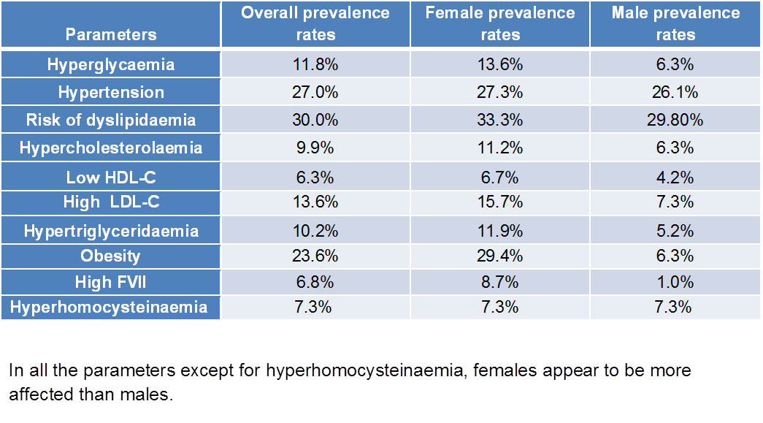

Slide 16
Parameters | Country/ population | Prevalence rates | Prevalence rates at Ga-Mothapo
Hyperglycaemia | African-Americans | 14.6% | 11.8%
 | England | 7.4%
Hypertension | African-Americans | 43.0% | 27.0%
 | Ontario blacks | 19.8%
Risk of dyslipidaemia | Jordan | 75.7% | 30.0%
 | USA | 53%
Hypercholesterolaemia | Jordan | 48.8% | 7.3%
Low HDL-C | ¨ | 40.7% | 6.3%
High LDL-C | ¨ | 40.1% | 13.6%
Hypertriglyceridaemia | ¨ | 43.3% | 10.2%
Obesity | Entire South African population | Males 29.0% Females 56.0% | Males 6.3% Females 29.4%
 | Europe | Males 19.8% Females 24.3%
High FVII | USA | 15.2% | 6.8%
Hyperhomocysteinaemia | North China | 51.6% | 7.3%
 | South China | 10.1%

Slide 17
DISCUSION
This study revealed that:
Females appeared to be more affected than males, with a relatively high predisposition to arterial thrombosis development.
Dyslipidaemia was positively associated with obesity.
Hyperglycaemia, obesity and dysilipidaemia were associated with high prevalence rate of hypertension.
There were isolated cases of increased plasma FVII activity, marking FVII as a possible independent risk parameter for arterial thrombosis.

Slide 18
Hyperhomocysteinaemia prevalence rates were higher in overweight or obese participants and showed an increase with age.
Obesity was found to be an important finding in hyperglycaemia, hypertriglyceridaemia, hypercholesterlaemia, low HDL-C, high LDL-C, increased FVII activity, hypertension and hyperhomocysteinaemia. (Sanlier and Yabanci).

Slide 19
CONCLUSION
The study’s Hypothesis was supported. Rural black African populations are characterised by clinical hyperlipidaemia, hyperglycaemia, mildly elevated FVII activity, high BP and mild hyperhomocysteinaemia.
High prevalence rates of overweight, obesity, high BP and hyperglycaemia were revealed at Ga-Mothapo
Females had a higher prevalence rates for overweight, obesity and hyperglycaemia than males.
More females were hypertensive than males.

Slide 20
High prevalence of obesity and dyslipidaemia at Ga-
Mothapo highlighted obesity and dyslipidaemia as health
problems among the rural populations.
The study indicated an increased risk for the Ga-Mothapo
population to develop arterial thrombosis, cardiovascular
disease and hypertension as complications.
Arterial thrombosis should be considered a potential health hazard among rural black communities.

Slide 21
RECOMMENDATIONS
With regards to the findings of this study, the following is recommended:
Interventions by the Department of Health in the Limpopo Province(Nobody clinic) are important to educate the community about these risk factors and how to control and prevent them.
Educational campaigns should be conducted to alert the Ga-Mothapo community about good health practices, like healthy eating habits, healthy lifestyle and physical activity.
Intervention programmes should be implemented to control and reduce the risk factors for arterial thrombosis.

Slide 22
LIMITATIONS AND STRENGTHS OF THE STUDY
The limitation in this study was that there were fewer male participants.
The strength of the study was the positive response and willingness of the Ga-Mothapo community to participate in the study.

Slide 23
Department of Health & Social development Limpopo Province, the department of Education Limpopo Province, the Department of Education Kgakotlou Circuit Limpopo Province, Bakgaga Traditional Council Limpopo Province and University of Limpopo Turfloop.
Thank you very much!

Slide 24


